Slide 1

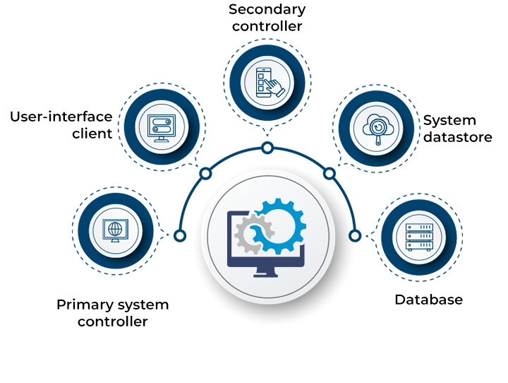
Sistem Terdistribusi IF2222
02: Review Networking
Husni
2022-23 Ganjil

Slide 2
Sistem Terdistribusi 2022
Mengenal Sistem Terdistribusi
Review Jaringan Komputer (layer 2, 3, dan 4)
Arsitektur Sistem Terdistribusi
Remote Procedure Calls (RPC)
Layanan Penamaan
Sinkronisasi Data (2 pekan)
Message Passing Interface (MPI)
Contoh Arsitektur: Hadoop, Pregel, Blockchain
Teknik Caching
Teknik Replikasi Data (2 pekan)
Basis Data Terdistribusi
Toleransi Kegagalan

Slide 3
Capaian Pembelajaran
Kuliah ini bertujuan memberikan pemahaman mendalam dan pengalaman langsung tentang:
Bagaimana sistem terdistribusi modern memenuhi tuntutan aplikasi terdistribusi kontemporer
Model pemrograman sistem terdistribusi dan mesin analitika
Prinsip untuk optimalisasi sistem terdistribusi
Prinsip yang menjadi basis dari sistem terdistribusi

Slide 4
Today…
Last Session:
Mengenal Sistem Terdistribusi
Today’s Session:
Network Types
Networking Principles: Layering, Encapsulation, Routing and Congestion Control
Announcements:

Slide 5
Learning Outcomes
After two lectures on networks, you will be able to:
Identify different types of networks
Describe various networking principles such as layering, encapsulation, and packet-switching, among others
Examine how packets are routed
Realize how congestion is controlled
Analyze the performance, scalability, and reliability of networks

Slide 6
Networks in Distributed Systems
A distributed system is a collection of components that communicate to solve a problem
Why should designers of distributed systems know about networks?
Networking issues severely affect performance, fault-tolerance, and security of distributed systems
E.g., Gmail outage on Sep 1, 2010 – Google Spokesman said “we had slightly underestimated the load which some recent changes placed on the request routers. … . few of the request routers became overloaded… causing a few more of them to also become overloaded, and within minutes nearly all of the request routers were overloaded.”

Slide 7
A Primer: Latency and Bandwidth
Case 1
Case 2
B
B
L
L
Case 3
B
L
B = Bandwidth (or Capacity) and L = Latency (or Delay)
B × L gives approximately the number of bits in flight
As B × L increases, uncertainty increases (more bits might get lost)
High value of B × L leads to “Buffer Bloat”

Slide 8

Networks in Distributed Systems
Networking Issue | Comments on a Distributed System Design
Performance
Scalability
Reliability
Security
Mobility
Quality-of-service
Affects choices of whether to optimize for network or other resources
Size of Internet is increasing; expect greater traffic and latency in future
Detect communication errors and perform error-checks at the application layer (end-to-end argument!)
Install firewalls at gateways; deploy end-to-end authentication; employ encryption, etc.,
Expect intermittent connection for mobile devices
Internet is best-effort. It is hard to ensure strict QoS guarantees for, say, multimedia data
Notes:
Authentication verifies the identity of a user or a service, and authorization determines their access rights.

Slide 9
Network Classification
Important ways to classify networks
Based on size
Body Area Networks (BAN)
Personal Area Networks (PAN)
Local Area Networks (LAN)
Wide Area Networks (WAN)
Based on technology
Ethernet Networks
Wireless Networks
Cellular Networks

Slide 10
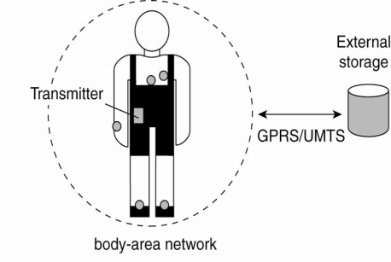
Network Classification – BANs and PANs
Body Area Networks (BAN):
Devices form wearable computing units
Several Body Sensor Units (BSUs) communicate with Body Central Unit (BCU)
Typically, low-cost and low-energy networking
Personal Area Networks (PAN):
PAN connects various digital devices carried by a user (mobile phones, tablets, cameras)
Low-cost and low-energy networking
e.g., Bluetooth
Notes:
10
The types of networks can be classified based on size:
Personal Area Networks: Various digital devices carried by the user is connected using a low-cost, low-energy network. e.g. Bluetooth

Slide 11


Network Classification – LAN
Computers connected by single communication medium
e.g., Twisted copper wire, optical fiber
High data-transfer-rate and low latency
LAN consists of
Segment
Usually within a department/floor of a building
Shared bandwidth, no routing necessary
Local Networks
Serves campus/office building
Many segments connected by a switch/hub
Typically, represents a network within an organization
Notes:
11
Local Area Networks: High speed computers connected through a single communication medium (optical, wired or wireless) . “Segment” is a part of the network that is connected by a single medium (e.g. ethernet cable). When a hosts inside a LAN transmits a packet, all other hosts can receive the packet. Hence, there is no need for routing. The bandwidth available is shared between all the hosts. A LAN can be made up of many segments. There is generally a host, which is called as switch or the hub, that helps to connect two or more segments. Communication between hosts in a LAN generally provides high bandwidth and low-delay. But most popularly used LANs, such as Ethernet-based LAN, does not not guarantee bandwidth or delay.

Slide 12

Network Classification – WAN
Generally, covers a wider area (cities, countries,...)
Consists of networks of different organizations
Traffic is routed from one organization to another
Routers
Bandwidth and latency
Vary
Worse than a LAN
Largest WAN = Internet

Slide 13




Brief Summary of Important Networks
(Based on Size)
A Segment
A Point-to-point link
Local Area Network (LAN)
A network of networks
A Network
Wide Area Network (WAN)
Notes:
13

Slide 14
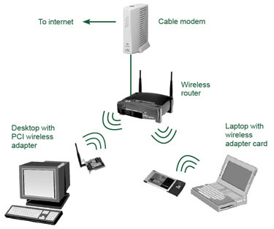
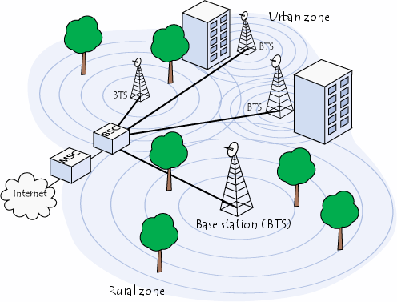
Types of Networks – Based on Technology
Ethernet Networks
Predominantly used in the wired Internet
Wireless LANs
Primarily designed to provide wireless access to the Internet
Low-range (100s of m), high-bandwidth
Cellular networks (2G/3G/4G/5G)
Initially, designed to carry voice
Large range (few kms)
Low-bandwidth

Slide 15
Typical Performance for Different Types of Networks
Network | Example | Range | Bandwidth (Mbps) | Latency (ms)
Wired LAN | Ethernet | 1-2 km | 10 – 10,000 | 1 – 10
Wired WAN | Internet | Worldwide | 0.5 – 600 | 100 – 500
Wireless PAN | Bluetooth | 10 – 30 m | 0.5 – 2 | 5 – 20
Wireless LAN | WiFi | 0.15 – 1.5 km | 11 – 108 | 5 – 20
Cellular | 2G – GSM | 100m – 20 km | 0.270 – 1.5 | 5
Cellular | 3G | 1 – 5 km | 348 – 14.4 | 100 – 500
Cellular | 4G | 16 km | 10- 100 | 36-48
Modern Cellular | 5G | 2 km | 50- 1000 | 10-30

Slide 16
Latency and Bandwidth
Case 1
Case 2
B
B
(WiFi)
(Ethernet)
L
L
Case 3
(WAN)
B
L
B = Bandwidth (or Capacity) and L = Latency (or Delay)
B × L gives approximately the number of bits in flight
As B × L increases, uncertainty increases (more bits might get lost)
High value of B × L leads to “Buffer Bloat”

Slide 17
Networking Principles
Network Protocols
Packet Transmission
Network Layers
Physical layer
Data-link layer
Network layer and routing
Transport layer and congestion control

Slide 18
Networking Protocols
If two entities want to communicate on a network, pre-defined agreements are necessary
How a message will be formatted?
How does the receiver know the last bit in the message?
How can a receiver detect if the message is damaged?
“Protocol” is a well-known set of rules and formats to be used for communication between the entities
Standardizing a well-known set of protocols supports communication among heterogeneous entities
Notes:
Networks allow an entity on one machine to communicate with another entity on another machine

Slide 19

Packet Transmission
Messages are broken up into packets
A packet is the unit of data that is transmitted between an origin and a destination
Packets can be of arbitrary lengths
Maximum size of the packet is known as Maximum Transmission Unit (MTU)
MTU prevents one host from sending a very long message
Each packet has two main fields
Header: Contains meta-information about the packet
e.g., Length of the packet, receiver ID
Data
Header
Data

Slide 20



Network Layers
Network software is arranged into a hierarchy of layers
Protocols in one layer perform one specific functionality
Layering is a scalable & modular design for complex software
Typical functionalities in a network software:
011100011 0011 011
Src
Functionality | Layer
Transmits bits over a transmission medium
Physical
Dest
Coordinates transmissions from multiple hosts that are directly connected over a common medium
Data link
Routes the packets through intermediate networks
Network
Destination machine
Handles messages – rather than packets – between sender and receiver processes
P1
P2
P3
Transport
Satisfies communication requirements for specific applications
Application

Slide 21
OSI Reference Model
Open Systems Interconnection (OSI) Reference Model
A layered networking model standardized by ISO
The model identifies various layers and their functionalities
Functionality | Layer | Example Protocols
Satisfy communication requirements for specific applications | Application | HTTP, FTP
Transmit data in network representation that is independent of representation in individual computers | Presentation | CORBA data representation
Support reliability and adaptation, such as failure detection and automatic recovery | Session | SIP
Handle messages – rather than packets – between sender and receiver processes | Transport | TCP, UDP
Route the packet through intermediate networks | Network | IP, ATM
Coordinate transmissions from multiple hosts that are directly connected over a common medium | Data-link | Ethernet MAC
Transmit bits over a transmission medium | Physical | Ethernet

Slide 22
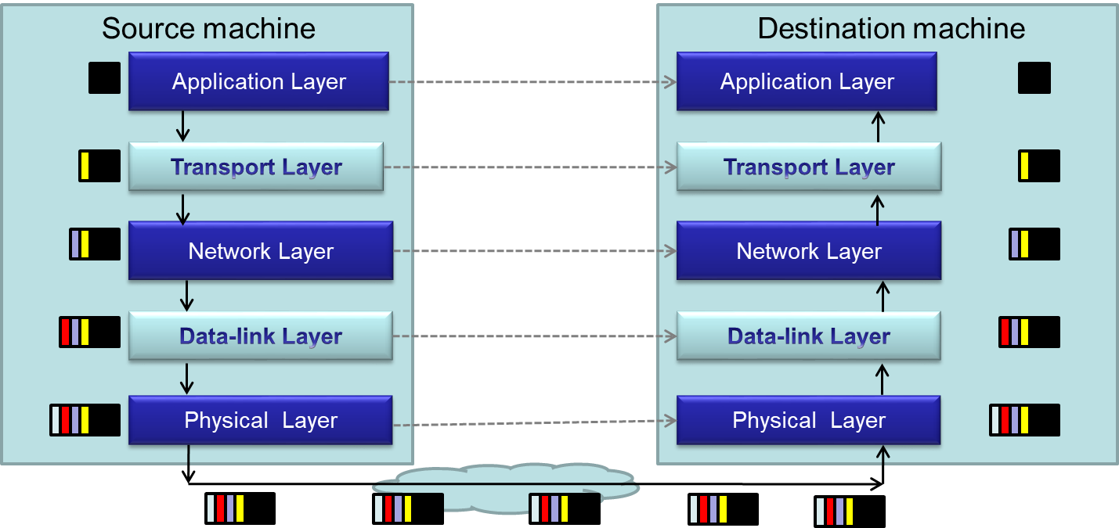
Packet Encapsulation
Encapsulation is a technique to pack and unpack data packets in a layered architecture

Slide 23
Layers that We Will Study Today
Physical layer
Data-link layer
Network layer
Transport layer

Slide 24
Layers that We Will Study Today
Physical layer
Data-link layer
Network layer
Transport layer

Slide 25
Physical Layer
Physical layer protocols transmit a sequence of bits over a transmission medium
Modulate the bits into signals that can be transmitted over the medium
Transmission Medium | Type of signal transmitted
Twisted-pair (Ethernet cable) | Electrical signal
Fiber Optic Circuits | Light signal
Wireless channel | Electro-magnetic signal
Data-link layer protocol
Bits
A physical layer protocol
Signal
Transmission Medium

Slide 26
Layers that We Will Study Today
Physical layer
Data-link layer
Network layer
Transport layer

Slide 27
Data-link Layer
Protocols in data-link layer ensure that the packets are delivered from one host to another within a local network
Data-link layer protocols provide two main functionalities:
How to coordinate between the transmitters such that packets are successfully received?
Coordination
How to identify another host on the local network?
Addressing over local networks

Slide 28

Coordination at Data-link Layer
A packet is not received successfully at the receiver if a sender transmits the data when another sender’s transmission is active
The packet is said to have experienced collision if it is not successfully received at the receiver
Collision is avoided by sensing the medium before transmission

Slide 29


Addressing over Local Networks
Each device that is connected to a network has a unique address called Medium Access Control (MAC) address
MAC addresses are six bytes long
e.g., 2A:D4:AB:FD:EF:8D
Approach:
Data-link layer broadcasts the packet over the medium
Receiver reads the packet header and checks if the packet is addressed to it
x
x

Slide 30
The Four Layers We Are Studying
Physical layer
Data-link layer
Network layer
Transport layer

Slide 31

Network Layer
Network layer protocols perform the role of routing
They ensure that a packet is routed from the source machine to the destination machine
Packets may traverse different LANs to reach the destination
Internet Protocol (IP) is a widely-used network layer protocol
IP addresses are typically used to identify machines
Router
Source
Destination

Slide 32
Router
A router is a device that forwards the packets between multiple networks
Routers are connected to two or more networks
Each network interface is connected to a LAN or a host
Packet travels up until the network layer on the router
Source machine
Router
Dest machine
A Router
Application
Application
LAN-1
LAN-3
Transport
Transport
Int-1
Int-2
Int-3
Network
Network
Network
Data-link
Data-link
Data-link
LAN-2
Physical
Physical
Physical

Slide 33
Routing Algorithm
Packets have to be transmitted in a series of hops through the routers
The series of hops that a packet takes is known as a route
Routing algorithm is responsible for determining the routes for the transmission of packets
Challenges for designing routing algorithms in the Internet:
Performance: The traffic across different networks vary
Router failures: Routers in the Internet may fail
R2
S
R1
R4
D
R4

Slide 34
Routing Algorithm (Cont’d)
Routing algorithms have two activities
Determine the next-hop taken by each packet
The algorithm should be fast and efficient
Dynamically update connectivity information
Maintain the knowledge of the network by monitoring routers and traffic
The above activities are distributed throughout the network
Routing decisions are made on an hop-by-hop basis
Information about possible next-hop routers is stored locally
Information is updated periodically
Let us study a simple routing algorithm called “Distance Vector Algorithm”

Slide 35
Distance Vector Algorithm
Distance Vector (DV) relies on graph theory to find the best route in a given network
It uses a well-known shortest path algorithm called Bellman-Ford
Two activities for the DV routing algorithm:
Determining the best next-hop at each router
Dynamically update connectivity information at all the routers

Slide 36
Distance Vector Algorithm – Next-hop Determination
Each router maintains a routing table that consists of:
Destination: The destination IP of the packet
Link: The outgoing link on which the packet should be forwarded
Cost: The distance between the router and the destination
E.g., Cost can be estimated as the delay for the packet to reach the destination
Router looks up the table to determine the best next-hop
Routing table at a router A
Hosts or local networks
Routers
To
Link
Cost
A
local
0
A
1
B
4
E
B
1
1
C
1
2
3
Links
2
D
3
1
E
1
2
D
C

Slide 37
Routing Tables for an Example Scenario
Routings from A
Routings from B
Routings from C
To
Link
Cost
To
Link
Cost
To
Link
Cost
A
local
0
A
1
1
A
2
2
B
1
1
B
local
0
B
2
1
C
1
2
C
2
1
C
local
0
D
3
1
D
1
2
D
5
2
E
1
2
E
4
1
E
5
1
Links
Routers
A
1
B
2
Routings from D
Routings from E
3
4
C
To
Link
Cost
To
Link
Cost
5
A
3
1
A
4
2
D
6
E
B
3
2
B
4
1
Hosts or local networks
C
6
2
C
5
1
D
local
0
D
6
1
E
6
1
E
local
0

Slide 38
Distance Vector Algorithm – Updating the Connectivity Information
Connectivity is updated by exchanging routing table
Router Information Protocol (RIP) is used for sending update messages
Send routing table to neighboring routers
Periodically, or when local table changes
When a neighbor’s routing table is received:
Case | If the received routing table … | Updates to the local routing table
1 | Has a new destination that is not in the local routing table | Update the Cost and Link
2 | Has a better-cost route to a destination in the local routing table | Update the Cost
3 | Has a more recent information | Update the Cost and Link

Slide 39
Pseudocode for RIP
Send: Each t seconds or when Tl changes, send Tl on each non-faulty outgoing link
Receive: Whenever a routing table Tr is received on link n:
for all rows Rr in Tr {
if (Rr.link != n) {
Rr.cost = Rr.cost + 1; // Update cost
Rr.link = n; // Update next-hop
if (Rr.destination is not in Tl) {
add Rr to Tl; // add new destination to Tl
}
else for all rows Rl in Tl {
if (Rr.destination = Rl.destination) {
// Rr.cost < Rl.cost : remote node has better route
// Rl.link = n : information is more recent
if (Rr.cost < Rl.cost OR Rl.link = n) {
Rl = Rr;
}
}
}
}
}
A
1
B
2
3
4
C
5
D
6
E
Tl at A
Case 1
Routing table at router A
To
Link
Cost
A
local
0
Case 2
D
3
1
C
3
3
Case 3
Tr recvd @ A from B on link n=1
Routing table of router B
To
Link
Cost
A
1
1
B
local
0
C
2
1
Notes:
39
Ask:
What happens when a link is broken?
Will this surely converge even if link breaks?
How can you take care of link-quality? Say link A-B is 10Gbps Ethernet link and link A-C is 2Mbps wireless link.

Slide 40
Summary: Routing over Internet
Each machine over the Internet is identified by an IP Address
Source machine transmits the packet over its local network
Intermediate routers examine the packet, and forward it to the best next-hop router
If the destination is directly attached to the local network of a router, the router forwards the packet over the respective local network
Routers exchange information to keep an up-to-date information about the network

Slide 41
Layers that we will study today
Physical layer
Data-link layer
Network layer
Transport layer

Slide 42
Transport Layer
Transport layer protocols provide end-to-end communication for applications
This is the lowest layer where messages (rather than packets) are handled
Messages are addressed to communication ports attached to the processes
Transport layer multiplexes each
packet received to its respective port
Destination machine
P1
P2
P3
Transport layer protocol
Network layer protocol

Slide 43
Simple Transport Layer Protocols
Simple transport protocols provide the following services:
Multiplexing Service
Connection-less Communication: The sender and receiver processes do not initiate a connection before sending the message
Each message is encapsulated in a packet (also called as datagram)
Messages at the receiver can be in different order than the one sent by the sender
E.g., User Datagram Protocol (UDP)

Slide 44
Advanced Transport Layer Protocols
Advanced transport layer protocols typically provide more services than simple multiplexing
Transmission Control Protocol (TCP) is a widely-used protocol that provides three additional services:
Connection-oriented Communication
Reliability
Congestion Control

Slide 45
1. Connection-Oriented Communication
Sender and receiver will handshake before sending the messages
Handshake helps to set-up connection parameters, and to allocate resources at destination to receive packets
Destination provides in-order delivery of messages to the intended process
Destination will buffer the packets until previous packets are received
It will then deliver packets to the process in the order that the sender had used
Source machine
Destination machine
P1
P1
P3
P1
P2
P3
Shall I send?
TCP protocol
TCP protocol
OK. Start sending

Slide 46
2. Reliability
Packets may be lost in the network due to buffer overflows at the router or transmission error(s)
In TCP, destination sends an ACK to the sender
If ACK is not received at the sender, the sender will infer a packet error, and retransmit the packet

Slide 47
3. Congestion Control
The capacity of a network is limited by the individual communication links and routers
Limited buffer space and link-bandwidth
What happens if a source transmits packets at a rate that is greater than the capacity of the network?
Packets drop at intermediate routers
Corresponding ACKs will NOT be received at the source
The source retransmits
More packets build-up on the router queue
The network collapses

Slide 48
3. Congestion Control (Cont’d)
To avoid congestion, two functionalities can be adopted
Detect congestion at routers
If a router expects a buffer overflow, it typically follows one of two strategies:
It drops packets and lets sources regulate upon observing packet losses
It sends an “Explicit Congestion Notification (ECN)” packet to sources
Regulate input at sources
If the TCP-sender concludes congestion (e.g., it receives an ECN packet), then it reduces its sending rate
Notes:
What is the best layer for congestion control?
Do you know any other protocol similar to TCP that is widely used?
When/where is congestion control important, where is it not?

Slide 49
Recap: Learning Objectives
You will identify how computers over the Internet communicate
Specifically, after the two lectures in networking you will be able to:
Identify different types of networks
Describe networking principles such as layering, encapsulation, and packet-switching
Examine how packets are routed and how congestion is controlled
Analyze scalability, reliability, and fault-tolerance over the Internet

Slide 50
Next Class
Arsitektur Sistem Terdistribusi

